Slide 1
TDC1 Module - Mechanical Engineering
Heat Transfer Analysis
Vibration Analysis
Fatigue Analysis
TDC1 Spring 2009
Team Plan B Instructors
Austin Dionne Michelle Hutchins
Greg Hovagim David Vaillette
Carlos Lazo Gary Batchelder
Nate Soule

Slide 2
Heat Transfer
Week 1:
Thermal Management of a Circuit Board
Mechanical Engineering
Team Plan B
Austin Dionne
Greg Hovagim
Carlos Lazo
Nate Soule (Team Lead)

Slide 3
Problem Statement
Perform thermal analysis of current circuit design
  Calculate steady-state temperature across the board
  Calculate steady-state junction temperature for each component
  Determine if the design meets junction temperature criteria
Produce an alternative circuit design
  Must meet thermal and design requirements
    Maximum junction temperature must be below 105°C
    Devices may not be placed within 0.25’’ of any edge, or any other device
  Provide thermal design recommendations

Slide 4
Assumptions
Top/bottom edges of board have zero heat flow
Left edge temperature = y, Right edge temperature = 20 – y
  This is done to model a fluid flow path starting from the bottom left of the board, traveling clockwise to the bottom right of the board
  The y represents physical displacement, and not nodal count
Board temperature for each device is the average temperature of the board under the device
All components operate continuously at a constant power dissipation
During operation, the temperature will remain constant at all points on the board, e.g. steady-state
Conduction across the board is two-dimensional
Thermal conductivity is constant across the board

Slide 5
Method of Analysis
Implemented the Finite Difference (FD) method using Excel to model the thermal profile of the circuit board
  Circuit board divided into 21x21 mesh of nodes spaced 0.5’’ apart
  Utilized Successive Over-Relaxation (SOR) technique to decrease settling time
    Attempted different SOR values to see which experiment yielded the smallest number of iterations
  Initial temperature for each node was set to 100°C
    Estimated based on expected steady-state temperature
  Junction temperatures calculated once steady-state was achieved

Slide 6
Method of Analysis cont’d
Convergence Criteria
  Steady-state temperature difference threshold of 0.001°C
    Chosen small enough to provide sufficient accuracy and large enough to minimize run time

Slide 7

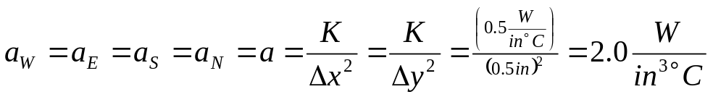
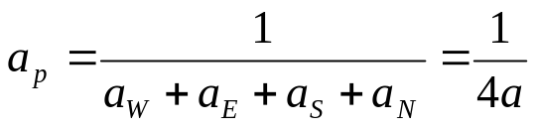
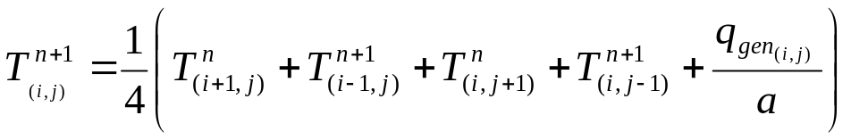
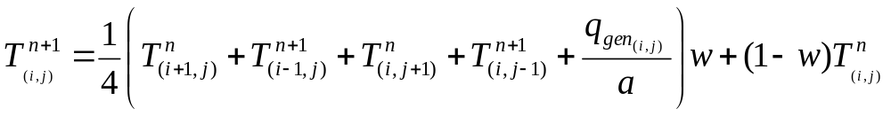
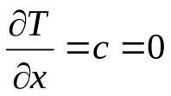
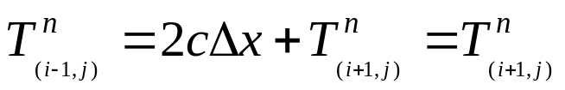
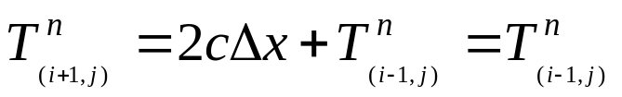
Method of Analysis – Equations Used
Distances Between Nodes
FD Coefficients
FD Iteration Equation
Weighted FD Iteration Equation
Top/Bottom Edge Assumption
Temp. at Top/Bottom Edge

Slide 8
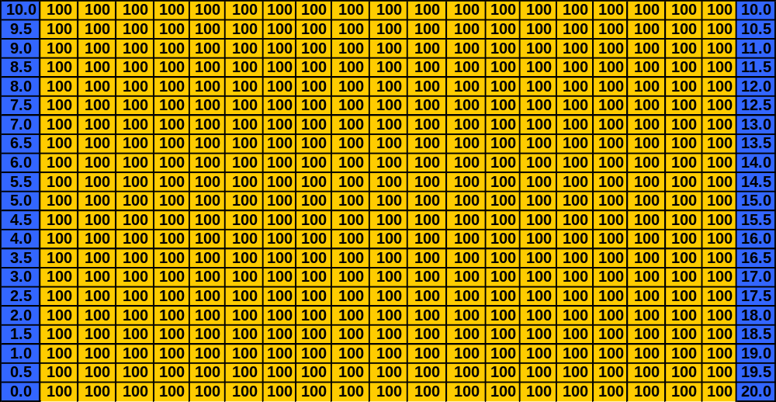
Initial Board Temperature Layout
Layout of our Board Temperature prior to beginning Finite Difference Method:

Slide 9
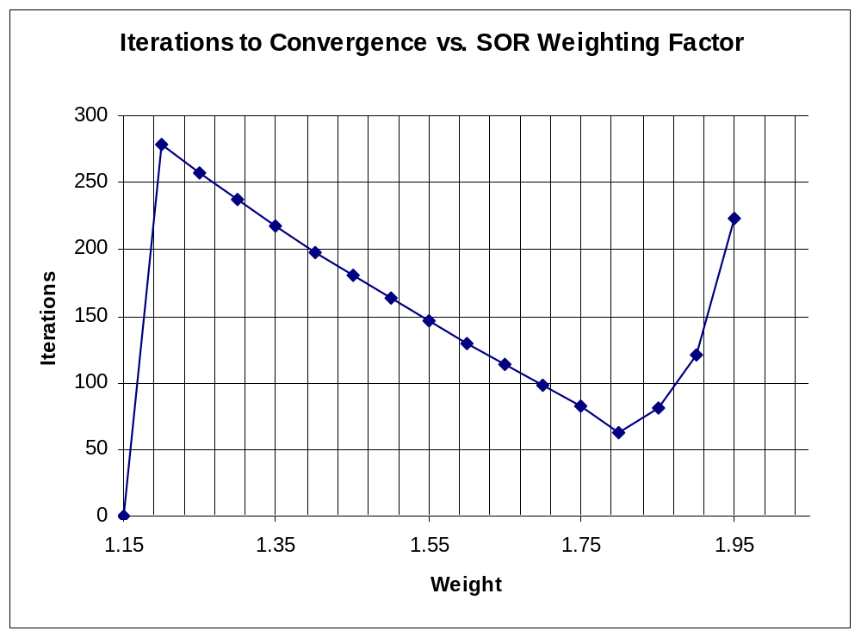
Successive Over-Relaxation (SOR)
Weight | Iterations
1 | -
1.05 | -
1.1 | -
1.15 | -
1.2 | 279
1.25 | 257
1.3 | 237
1.35 | 217
1.4 | 198
1.45 | 181
1.5 | 163
1.55 | 147
1.6 | 130
1.65 | 114
1.7 | 98
1.75 | 82
1.8 | 63
1.85 | 81
1.9 | 121
1.95 | 223
2 | -

Slide 10
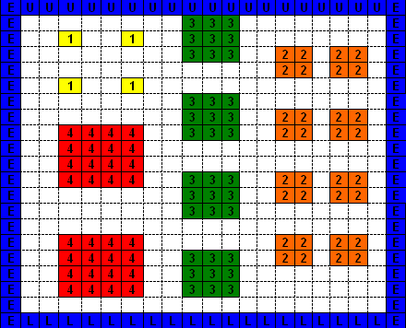

Results - Original Design
*** See Appendix for SOR Graph ***
Component Arrangement:
U13
U1
U2
U5
U6
U3
U4
U14
U7
U8
SOR Value = 1.8
U17
U15
U9
U10
U18
U11
U12
U16

Slide 11
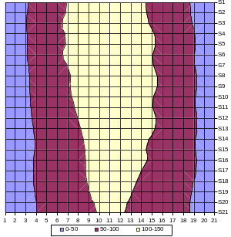
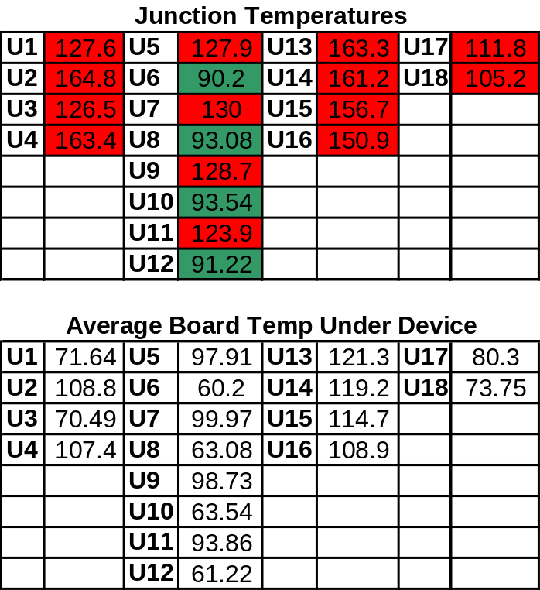
Results - Original Design cont’d
*** SEE APPENDIX FOR BOARD TEMPERATURE LAYOUT ***
Thermal Profile
U13
U1
U2
U5
U6
U3
U4
U14
U7
U8
U17
U15
U9
U10
U18
U11
U12
U16
Temp, °C
Temp, °C

Slide 12
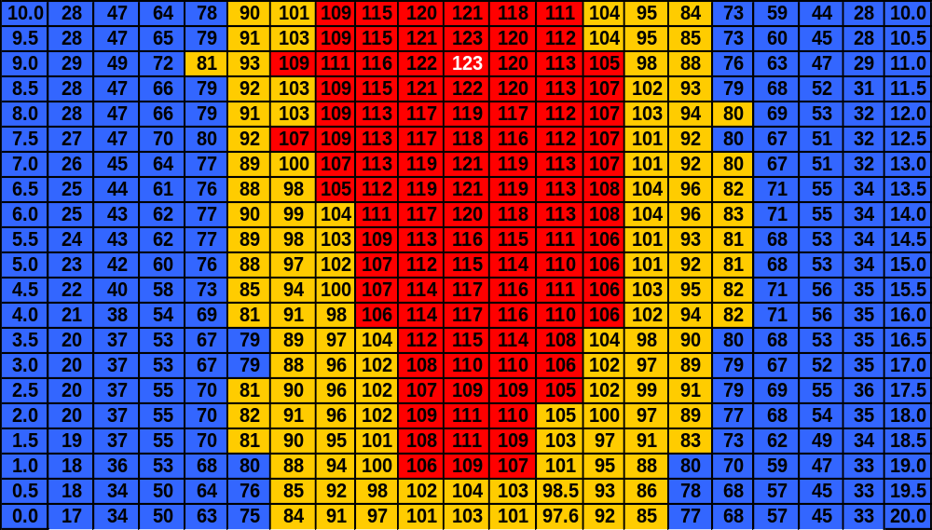
Temperature Field – Original Design
Max Temperature is 123.36 °C

Slide 13
Results - Original Design cont’d
Almost all component junction temperatures exceeded maximum allowable junction temperature!
  No components were adjacent to the cooling edge
  Component heat generation was not considered
  Layout created a center hot-spot

Slide 14
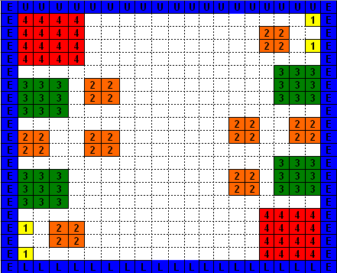
Results - Plan B PCB Layout
*** See Appendix for SOR Graph ***
New Component Arrangement (Plan B):
U17
U1
U5
U2
U13
U14
U6
SOR Value = 1.8
U7
U8
U9
U10
U15
U16
U11
U18
U3
U12
U4

Slide 15
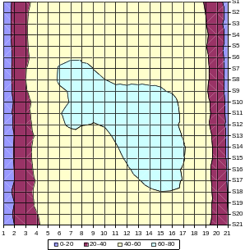
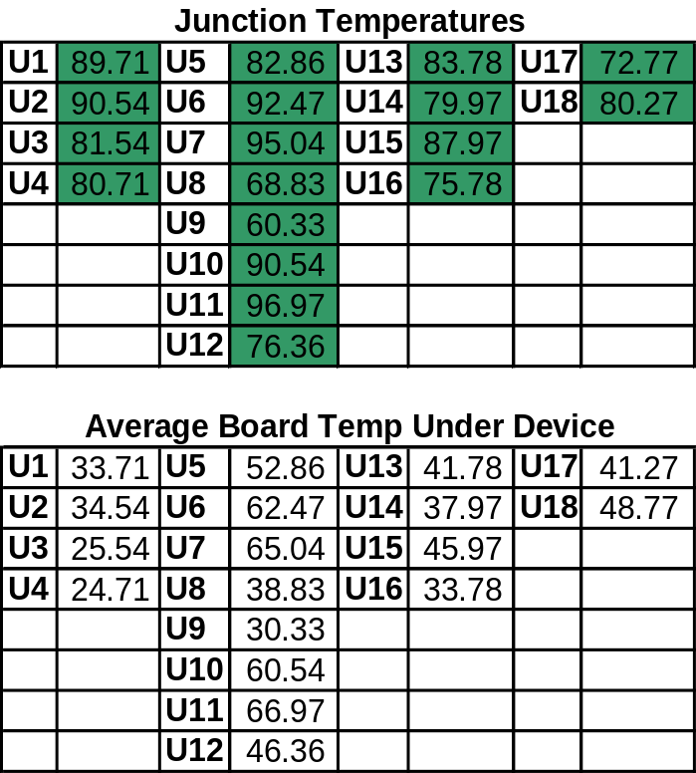
Results - Plan B PCB Layout cont’d
*** SEE APPENDIX FOR BOARD TEMPERATURE LAYOUT ***
Thermal Profile
U17
U1
U5
U2
U13
U14
U6
U7
U8
U9
U10
U15
U16
U11
U18
U3
U12
U4
Temp, °C

Slide 16
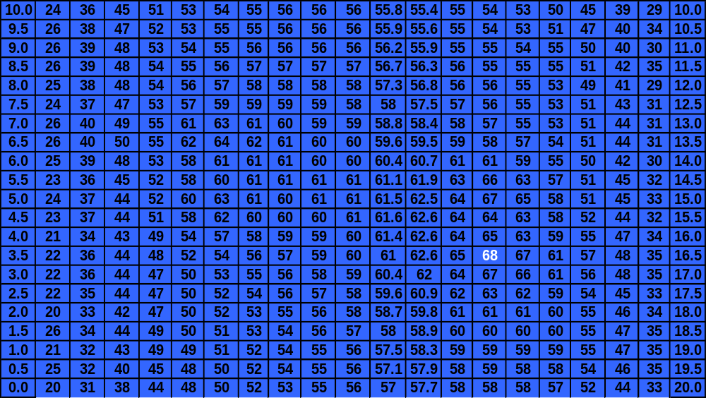
Temperature Field – Plan B Design
Max Temperature is 67.84 °C

Slide 17
Results - Plan B PCB Layout cont’d
All component junctions temperatures did not exceed maximum allowed temperature!
  New layout placed components along cooling edge
  Considered each component’s heat generation
  Avoided placement towards the center where heat dissipation is the most difficult

Slide 18
Specific Suggestions for Re-design
  If cooling source is available, place the hottest components near it (greatest power dissipation)
  Consider the heat generation for each component
  Avoid component placement towards the center where heat dissipation is the most difficult

Slide 19
Vibration Analysis
Week 2:
Vibration Analysis Problem Set
Mechanical Engineering
Team Plan B
Austin Dionne (Team Lead)
Greg Hovagim
Carlos Lazo
Nate Soule

Slide 20





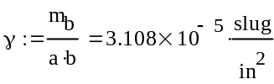



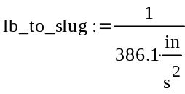


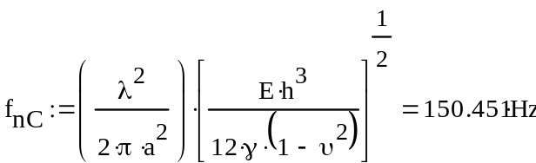
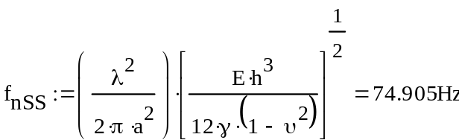
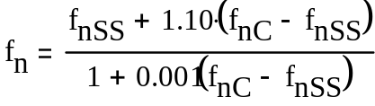

Problem 1 – Part 1 – Analysis of Circuit Card
Team Plan B used MATHCAD to track our units and Engineering Calculations.
Board Dimensions:
Poisson’s Ratio:
Board Weight:
Mass Per Unit Area:
Board Mass:
Modulus of Elasticity:
Two Cases to Analyze:
Case < 100 Hz, Clamped:
Case > 600 Hz, Simply Supported:
Frequency Parameter:
Frequency Parameter:
Natural Frequency:
Natural Frequency:
Therefore, the predicted Natural Frequency is:

Slide 21
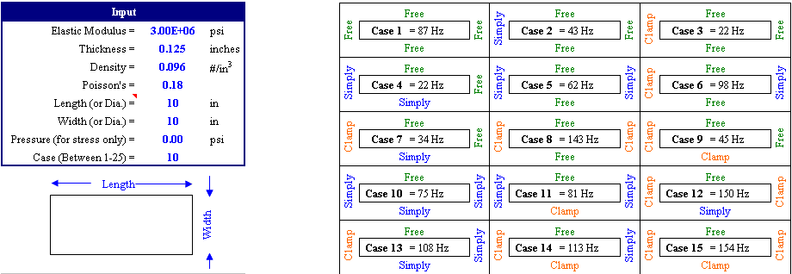
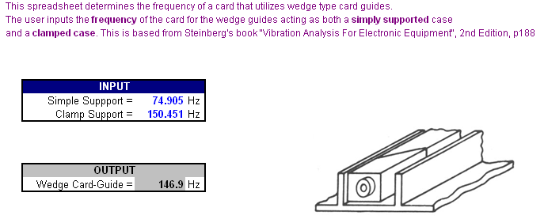
Problem 1 – Part 1 – Validation of Plan B Solution
Using Frequency.xls, Plan B confirmed Clamped and Simply Supported Calculations.
Using wedge_lok.xls, Plan B confirmed the predicted frequency.

Slide 22
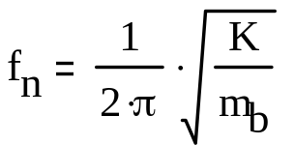

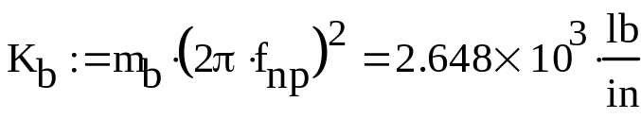
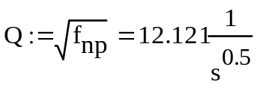
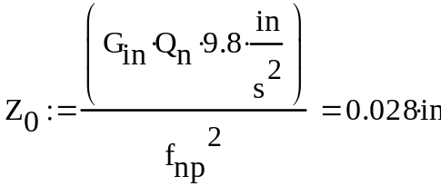
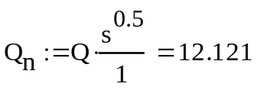

Problem 1 – Part 2 – Stiffness
Problem 1 – Part 3 – Transmissibility
We rearrange the equation to solve for stiffness variable K.
We know that our predicted natural frequency = 146.907 Hz.
Substituting into our equations, we calculate:
Transmissibility can be described as:
Making Transmissibility unitless:
The Maximum Displacement is:

Slide 23
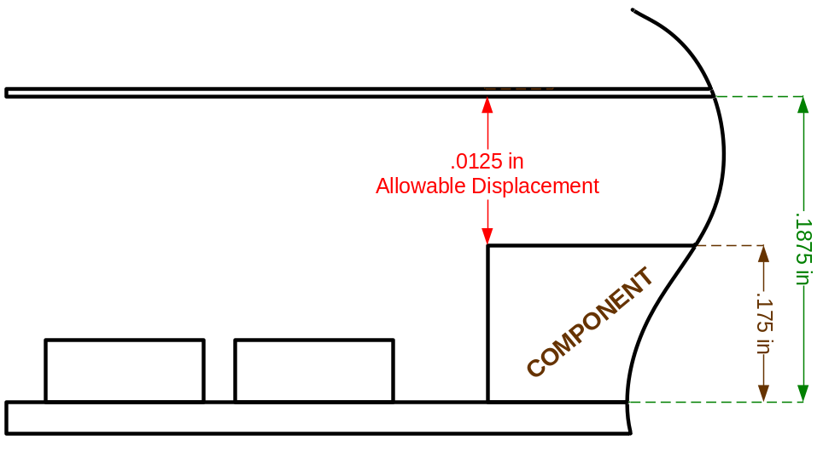
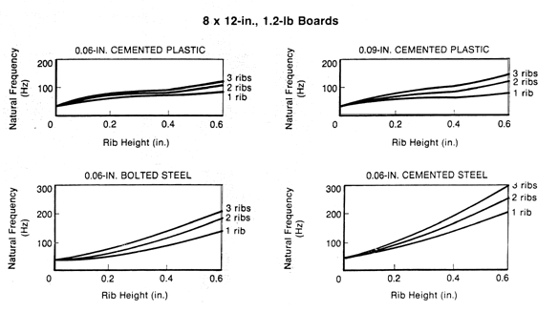
Problem 1 – Part 4 – Allowable Displacement
Since our maximum displacement, 0.028’’ is > the allowable displacement, 0.0125’’…
The component will hit the adjacent wall during sine vibration.
In order to decrease the maximum displacement during sine vibration testing, the predicted natural frequency of the system would need to be increased. One feasible way of doing this would be to add ribbing to the PCB (printed circuit board).
Ribbing would be placed along the entire length of the PCB. The number of ribs, the height of the ribs, and the way they are connected to the board would all play a factor into the end natural frequency of the PCB. The ribs should be lightweight, so as to not add too much more weight to the board itself. The following graphs gives an example of the sorts of gains one would expect from adding 1-3 ribs on a 8x12in board.

Slide 24
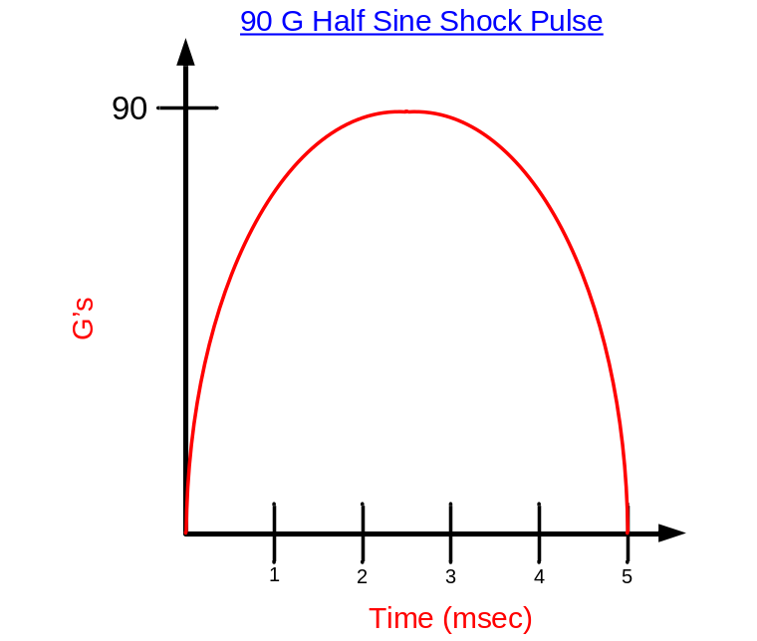


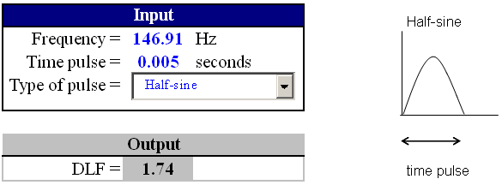
Problem 2 – Part 1 - Shock Analysis of the PC Card
1) The following is a picture of the 90 G, 5 ms half sine shock pulse:
We calculate our fn * t first in order to determine the DLF of the system, assuming that we are using 146.907 Hz as the natural frequency of our system:
From analyzing the DLF curves provided, we determined that our DLF is:
This can also be confirmed by using DLF(shock).xls, as seen below:

Slide 25
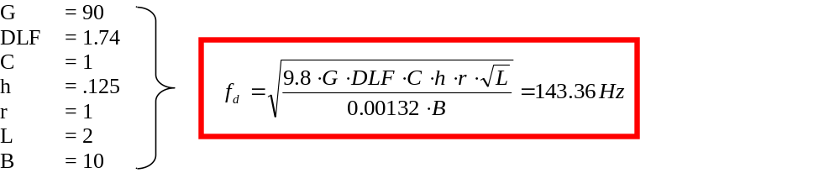
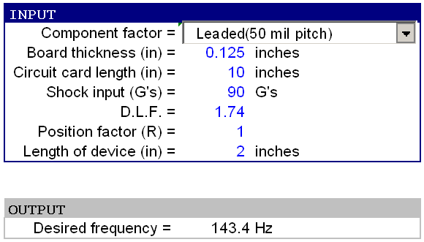
Problem 2 – Part 1 - Shock Analysis cont’d
We compute our desired frequency using the formula below:
This can be confirmed by using Avip-E.xls, as seen below:
Since our desired frequency, 143.36 Hz < the system’s natural frequency of 146.907 Hz:
The circuit will be capable of satisfactory operation in such an environment.

Slide 26


Problem 2 – Part 2 - Component Deflections
G = 90
DLF = 1.74
C = 1
H = 0.125
R = 1
L = 2
B = 10
Fn = 146.907
The desirable displacement of the board is greater than the actual displacement seen.

Slide 27


Problem 2 – Part 3 - With and Without Rebound
t = 0.005
G = 90
g = 386.1
C = 1, NR
= 2, FR

Slide 28
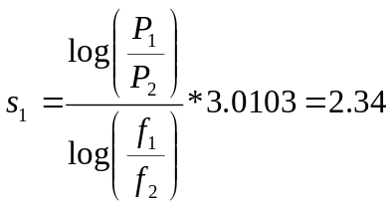
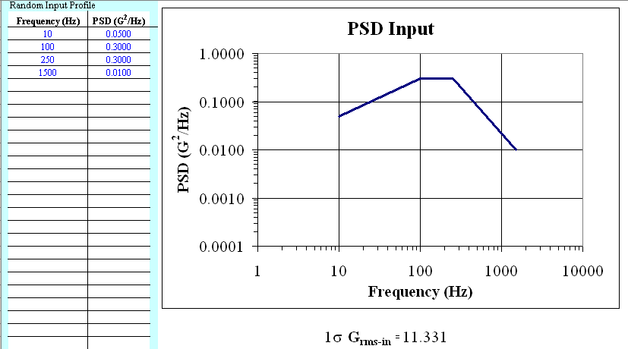
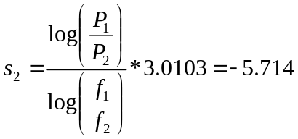
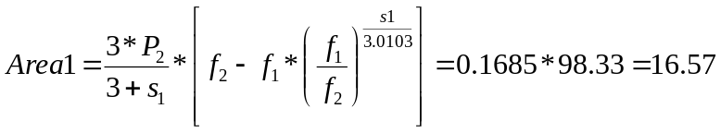

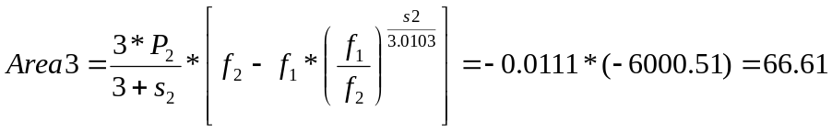
Problem 3 – Part 1 - Random Vib of Circuit Card
The 1σ GRMS value is determined through the following calculations:
Slope 1:
Slope 2:

Slide 29


Problem 3 – Part 2 – 3σGrms and 3σ Peak Displacement
Problem 3 – Part 3 – Diff b/w Sinusoidal & Random Vibration
To find the 3σ displacement, simply multiply the 1σ displacement by a factor of 3:
Use the following equation to compute the 3σ peak displacement of the board:
Difference between Sinusoidal and Random Vibration:
A sinusoidal vibration is a single frequency vibration that changes uniformly over time. A random vibration is a dynamic combination of frequencies interlaced to create its own upper and lower frequency limits changing non-uniformly in time. Overall, random vibration is a more accurate model to the actual operating environment than sinusoidal vibration. The unpredictability factor of random vibration provides a great amount of insight versus the sweep technique of sinusoidal vibration.

Slide 30
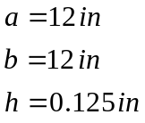





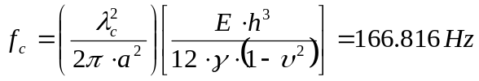

Problem 4 – Part 1, 2, 3 - Acoustic Analysis of the Chassis Cover
The one-third octave bandwidth of the center frequency is found using the equations below:
Board Dimensions
Board Density
Modulus of
Elasticity
Poisson’s
Ratio
Frequency
Parameter
One-Third Octave:
Mass per unit area
Natural Frequency
Sound Pressure Spectral Density:
Equivalent Pressure as seen on CC:

Slide 31
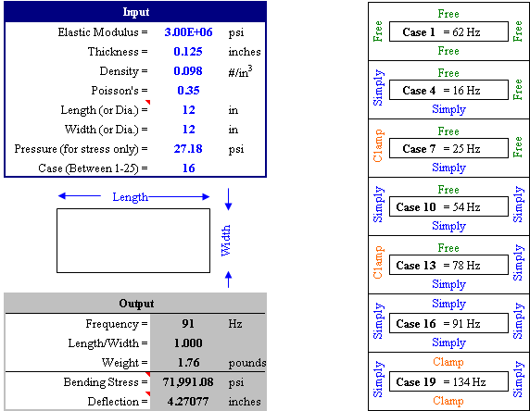


Problem 4 – Part 4 – Stress & Deflection

Slide 32
Problem 4 – Part 5
Since there is currently 1.281 inches of deflection, stiffening the chassis is a necessity. This can be done by adding ribs to the cover. The center frequency of the system will go up, which will in turn reduce the sound pressure spectral density. A reduction in sound pressure spectral density will reduce the equivalent pressure that will be seen on the circuit card surface, which will reduce the overall deflection seen on the chassis cover.

Slide 33

Fatigue Analysis
Week 3:
Fatigue Analysis Problem Set
Mechanical Engineering
Team Plan B
Austin Dionne
Greg Hovagim
Carlos Lazo (Team Lead)
Nate Soule

Slide 34
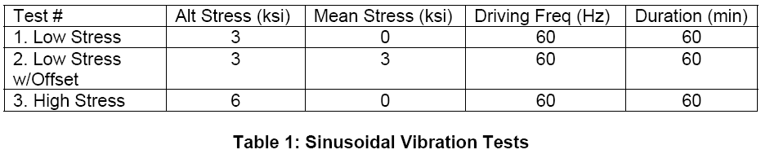



Problem 1 – Sinusoidal Vibration and CDI
Evaluated the fatigue characteristics of the G10 circuit board
Performed analysis on three tests applying sinusoidal vibration
Required Number of Cycles
Fatigue Strength Coefficient
Fatigue Strength Exponent

Slide 35

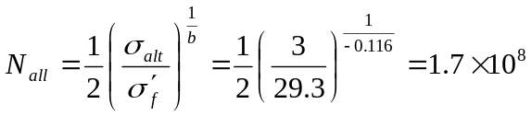

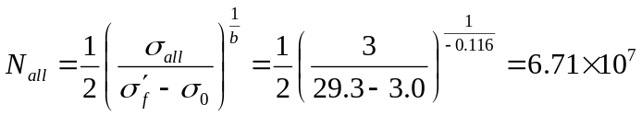



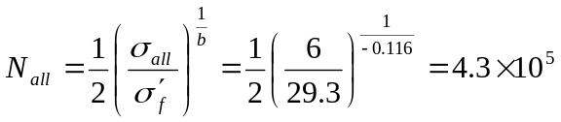



Problem 1 – Results
Test 1
Alternating Stress
Test 2
Alternating Stress
Number of Allowable Cycles
Mean Stress
Allowable Number of Cycles
Damage Index
Damage Index
Test 3
Alternating Stress
Overall
Cumulative Damage Index
Allowable Number of Cycles
Damage Index
The G10 board will survive the tests.

Slide 36
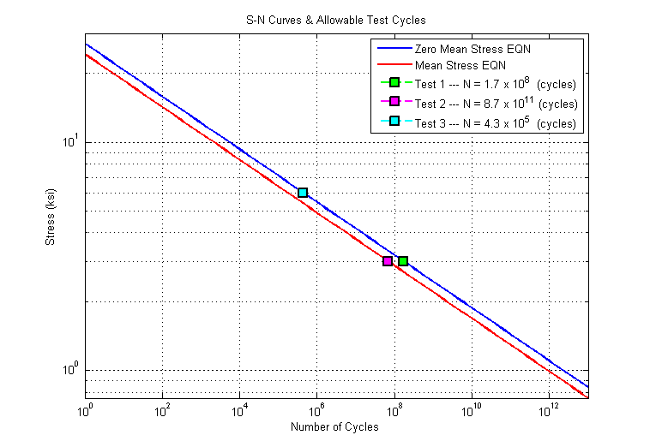
Problem 1 – S-N Curve

Slide 37
Problem 1 – Effects of Applying a Mean Stress
Conclusion:
Applying a equivalent mean stress did not make a significant difference in the damage index.
example: screwing a PCB to stand-offs
Doubling the alternating stress caused a very significant difference in the damage index.
example: Tacoma Narrows Bridge

Slide 38
Problem 2 – CTE Mismatch and Low Cycle Fatigue
Currently the G10 circuit board and attached components have significantly different CTEs.
This difference may cause damage at solder joints during thermal expansion.
We evaluated the current design and propose a change to the PCB that would reduce the potential for damage.

Slide 39

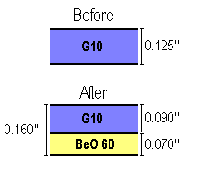




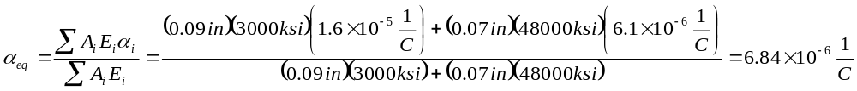
Problem 2 – Part A – CTE Mismatch and Low Cycle Fatigue
Properties of G10
Coefficient of Thermal Expansion
Selected Thickness of Layers
Modulus of Elasticity
Properties of Leadless Component
Coefficient of Thermal Expansion
Properties of BeO 60
Coefficient of Thermal Expansion
Modulus of Elasticity
New Equivalent Coefficient of Thermal Expansion

Slide 40







Problem 2 – Part B – CTE Mismatch and Low Cycle Fatigue
Temperature Change
We assume that change in temperature is the
same for the board and component
Empirical Non-Ideal Factor
Solder Joint High
Component Dimensions
½ Max Solder Joint Distance
Original Design
Shear Strain
Modified Design
Shear Strain

Slide 41







Problem 2 – Part C – CTE Mismatch and Low Cycle Fatigue
Fatigue Ductility Component
Weibull Shape Parameter
Acceptable Cumulative Failure Probability
Fatigue Ductility Exponent
Original Design
Allowable Number of Cycles
Modified Design
Allowable Number of Cycles
The modified board is able to survive more cycles, but is thicker and because it has multiple epoxies it will be more complicated and expensive to produce.

Slide 42
Problem 2 – Part D – CTE Mismatch and Low Cycle Fatigue
Suggestion for further improvement:
Use leaded components to reduce solder joint stress
Consider the effects on the thermal dissipation
Use thermal padding beneath component

Slide 43















Problem 3 – Part A – High Cycle Fatigue
Length of Board*
Allowable Board Deflection at 10x10⁶ Cycles
*The length used is 2x the actual to accommodate for the non-simply supported side.
Length of Component
Transmissibility
Component Type Factor
Root Mean Square Acceleration
Board Thickness
Component Position Factor (Center of Board)
Root Mean Square Deflection
Sine to Random Conversion Factor (Solder (63-37))
Stress Concentration Factor
Slope of S-N Curve
Number of Positive Non-Zero Crossings per Second

Slide 44






Problem 3 – Part A, B – High Cycle Fatigue
Allowable Number of Cycles
Cumulative Damage Index
For this placement the component will not remain intact throughout the test.
Component Position Factor (¼X, ¼Y)
Allowable Board Deflection at 10x10⁶ Cycles
Allowable Number of Cycles
Cumulative Damage Index
89602.5% Improvement
Repositioning the component made a significant difference and it will remain intact throughout the test.

Slide 45
Problem 3 – Part C – High Cycle Fatigue
Suggestion for board designer:
Place components along the edge of the PCB to minimize high cycle fatigue
This coincides with other suggestions for thermal design, because thermal dissipation was more difficult in the center of the board.

Slide 46









Problem 4 – Part A – Time Compression
Original Temperature Range
Original Number of Cycles
Time per Cycle
New Temperature Range
Fatigue Exponent
Leadless Components
Time Compression Relation
Leaded Components
Time Compression Relation
New Number of Cycles
New Number of Cycles
Improvement (Cycles)
Improvement (Cycles)
Improvement (Minutes)
Improvement (Minutes)

Slide 47







Problem 4 – Part B – Time Compression
Original Power Spectral Density
New Power Spectral Density
Original Number of Cycles
Time per Cycle
Fatigue Exponent
Time Compression Relation
New Number of Cycles
Improvement (Cycles)
Improvement (Hours)

Slide 48
Problem 4 – Part C – Time Compression
Warning about time compressing tests:
“Most often designs are constructed of many different materials having a variety of fatigue slopes. Thus, for a given time compression some components of the design will be over-tested while others will be under tested.”
- Fatigue Analysis Course Book

Slide 49
¿QUESTIONS?

